Slide 1
Fully Convolutional Networks for Semantic Segmentation
深度学习技术讨论会
Jonathan Long* Evan Shelhamer* Trevor Darrell
UC Berkeley
2017年6月16日

Slide 2
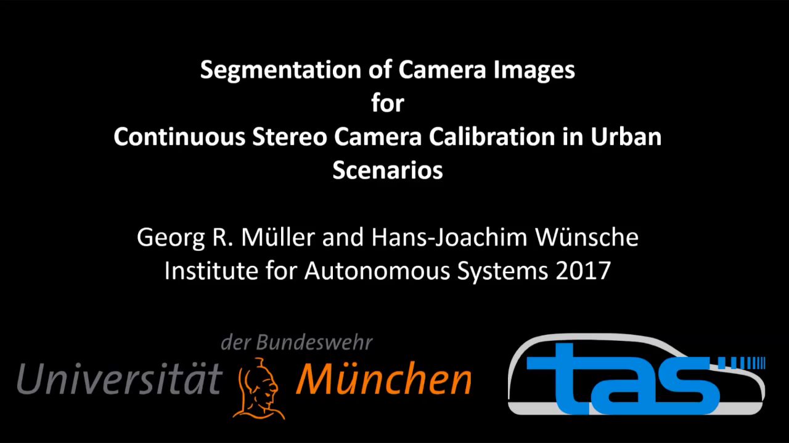
Notes:
慕尼黑联邦国防军大学

Slide 3
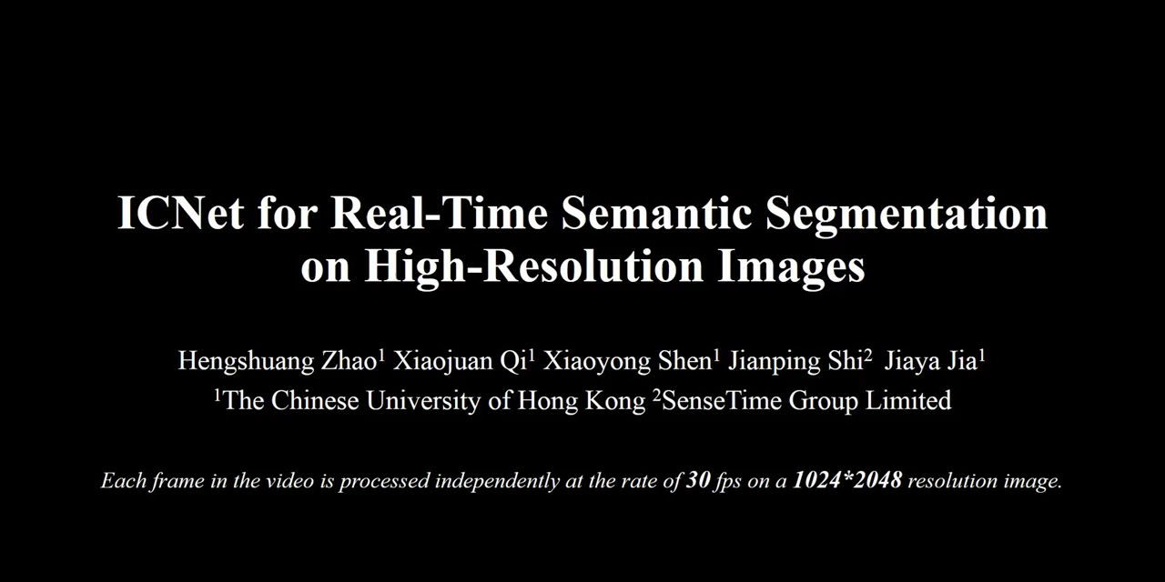
Notes:
香港中文大学，sensetime

Slide 4
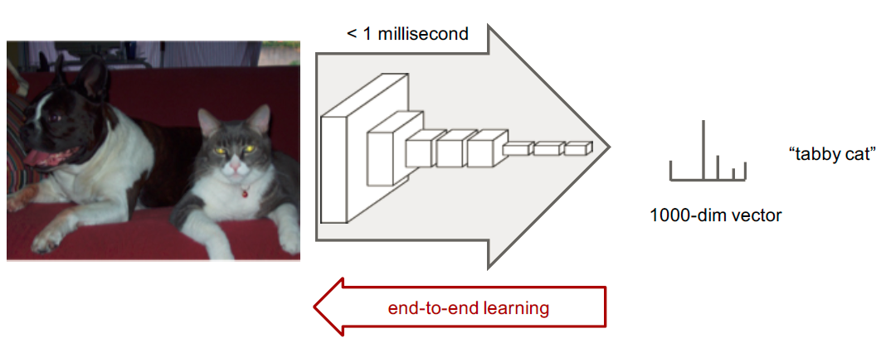
convnets perform classification

Slide 5
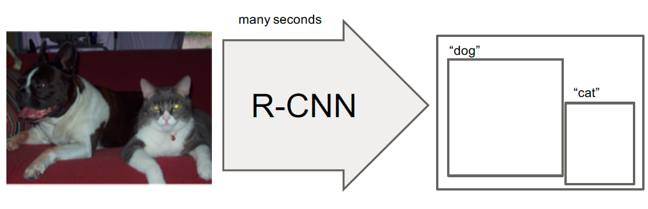
R-CNN does detection

Slide 6
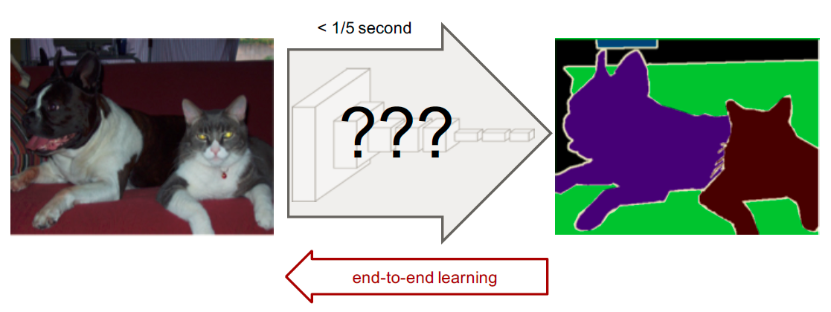

Slide 7
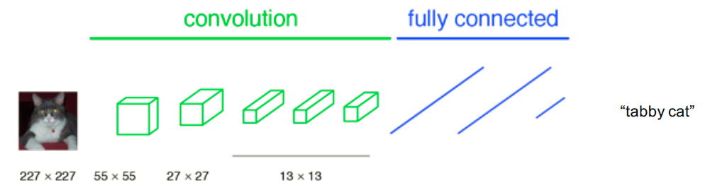
a classification network

Slide 8
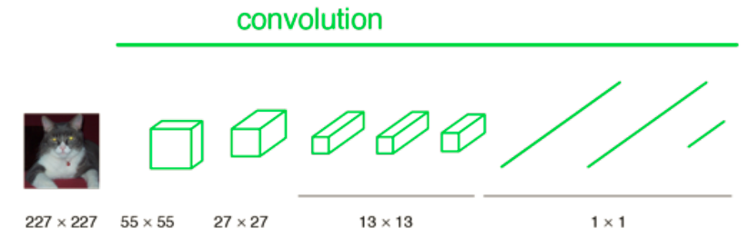
becoming fully convolutional

Slide 9
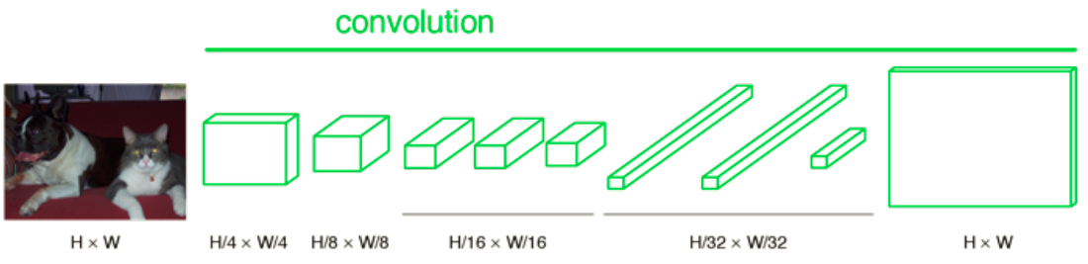
upsampling output

Slide 10
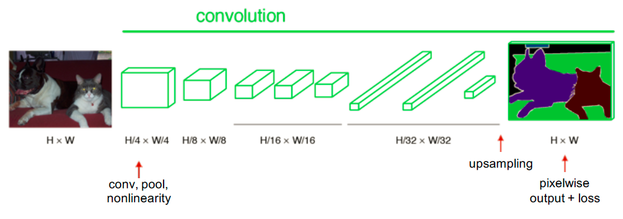
end-­to-­end, pixels-­to-­pixels network

Slide 11
Classifier to Dense FCN
Convolutionalize proven classification architectures: AlexNet, VGG, and GoogLeNet (reimplementation)
Remove classification layer and convert all fully connected layers to convolutions
Append 1x1 convolution with channel dimensions and predict scores at each of the coarse output locations (21 categories + background for PASCAL)
Upsampling via deconvolution

Slide 12
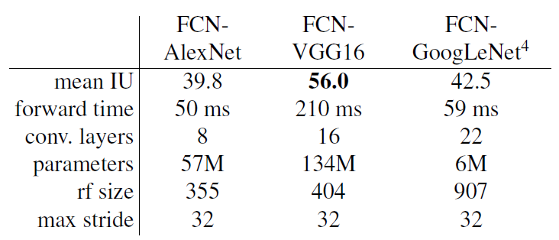
Classifier to Dense FCN
Cast ILSVRC classifiers into FCNs and compare performance on validation set of PASCAL 2011

Slide 13
Learnable Upsampling: “Deconvolution”
逆卷积（Deconvolution）相对于卷积在神经网络结构的正向和反向传播中做相反的运算。
The size of output layer is larger than that of input.
Densify sparse activations
Conceptually similar to convolution
Bases to reconstruct shape

Slide 14
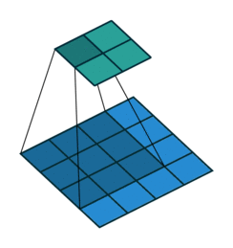
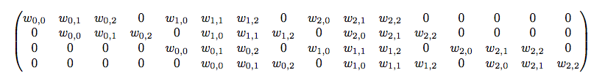
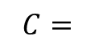
Learnable Upsampling: “Deconvolution”
正向传播-卷积
输入= 4x4，卷积Kernel=3x3, Stride=1, 输出=2x2
输入矩阵可展开为16维向量，记作
输出矩阵可展开为4维向量，记作
卷积运算可表示为
$$C=$$

Slide 15
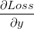
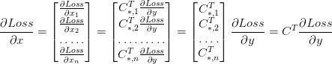
Learnable Upsampling: “Deconvolution”
反向传播
已知 ：
结论：所谓逆卷积其实就是正向时左乘 ，而反向时左乘 的运算。

Slide 16


Learnable Upsampling: “Deconvolution”
反卷积：kernel size = 3, stride = 1
input=2×2, output=4×4
反卷积：kernel size = 3, stride = 2
Input=3×3, output=5×5
Notes:
逆卷积可用于GAN(Generative Adversarial Network)生成图片

Slide 17
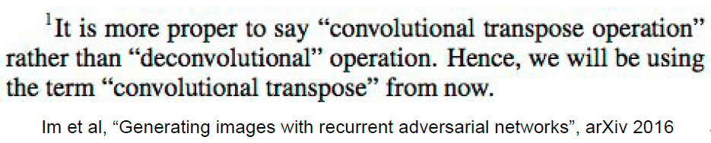
Learnable Upsampling: “Deconvolution”
× Bad name
“Deconvolution” is a bad name, already defined as “inverse of convolution”
√ Better names:
convolution transpose,
backward strided convolution,
1/2 strided convolution,
upconvolution

Slide 18
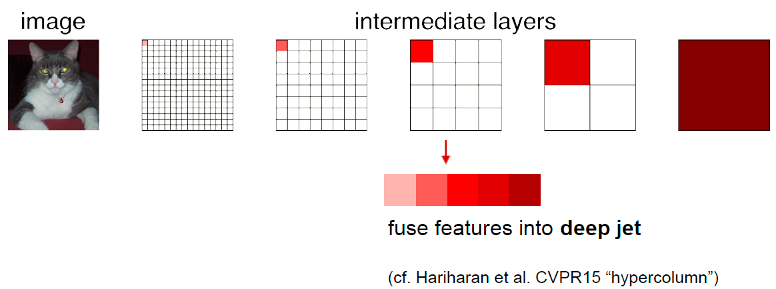
spectrum of deep features
combine where (local, shallow) with what (global, deep)

Slide 19
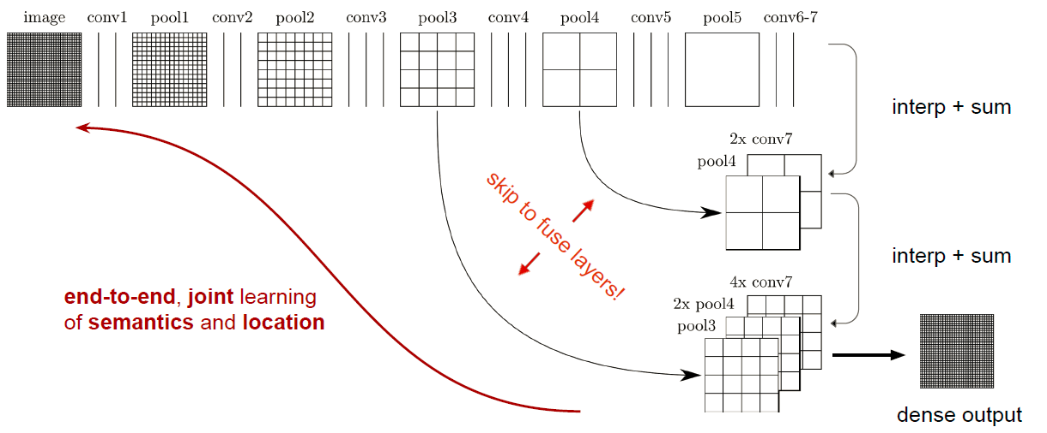
skip layers

Slide 20
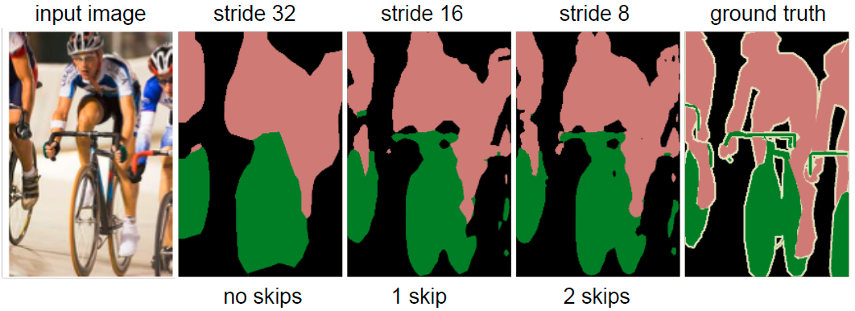
skip layer refinement

Slide 21
总结
Input images with arbitrary sizes
Reinterpret standard classification convnets as “Fully convolutional” networks (FCN) for semantic segmentation
Use AlexNet, VGG, and GoogleNet in experiments
Novel architecture: combine information from different layers for segmentation
State-of-the-art segmentation for PASCAL VOC 2011/2012, NYUDv2, and SIFT Flow at the time
Inference less than one fifth of a second for a typical image

Slide 22
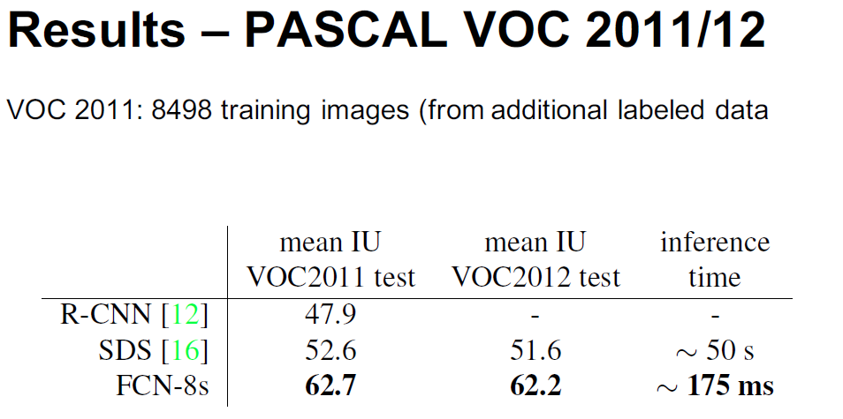

Slide 23
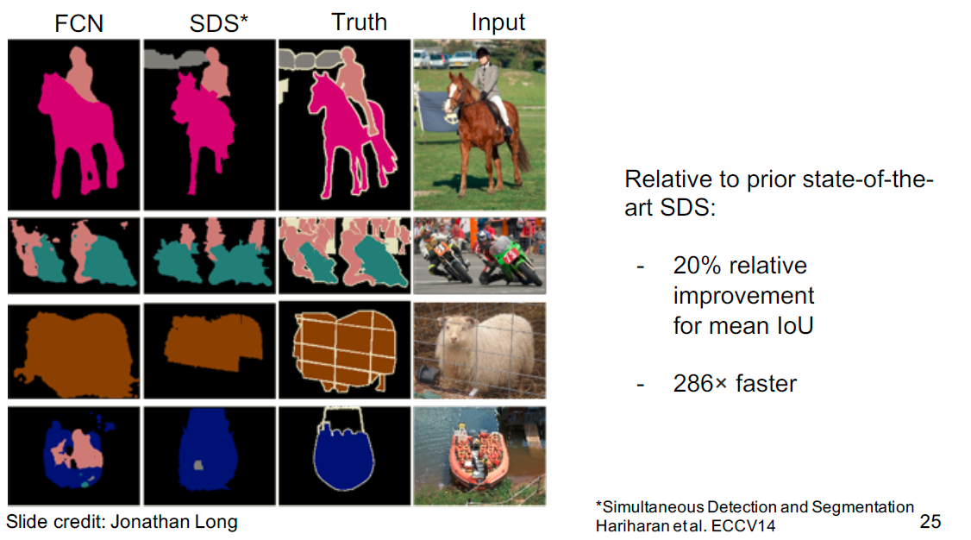

Slide 24
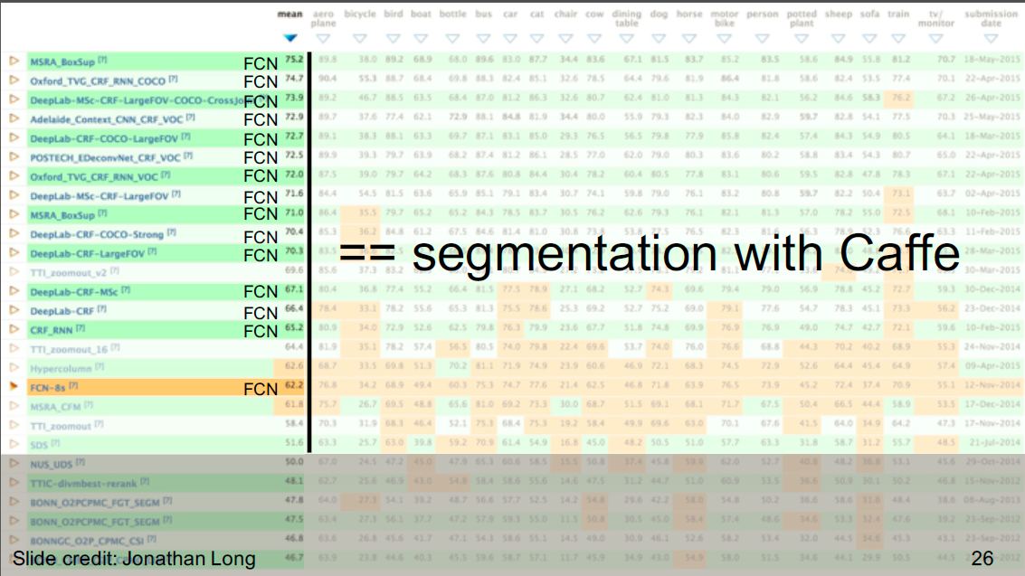

Slide 25
参考资料
[1] Long, Shelhamer, and Darrell, “Fully Convolutional Networks for Semantic Segmentation”, CVPR 2015.
[2] Fei-Fei Li & Andrej Karpathy & Justin Johnson, Lecture 13: Segmentation and Attention. (PPT)
[3] Gordon Christie. Fully Convolutional Networks for Semantic Segmentation. (PPT)

